Slide 1
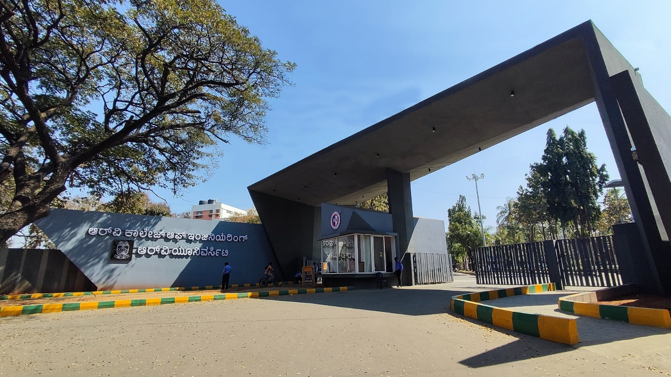
Fast Food Monitoring Using AR and Digital Twin
Manufacturing Processes, 31

Slide 2
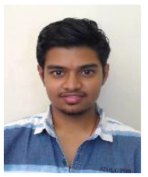


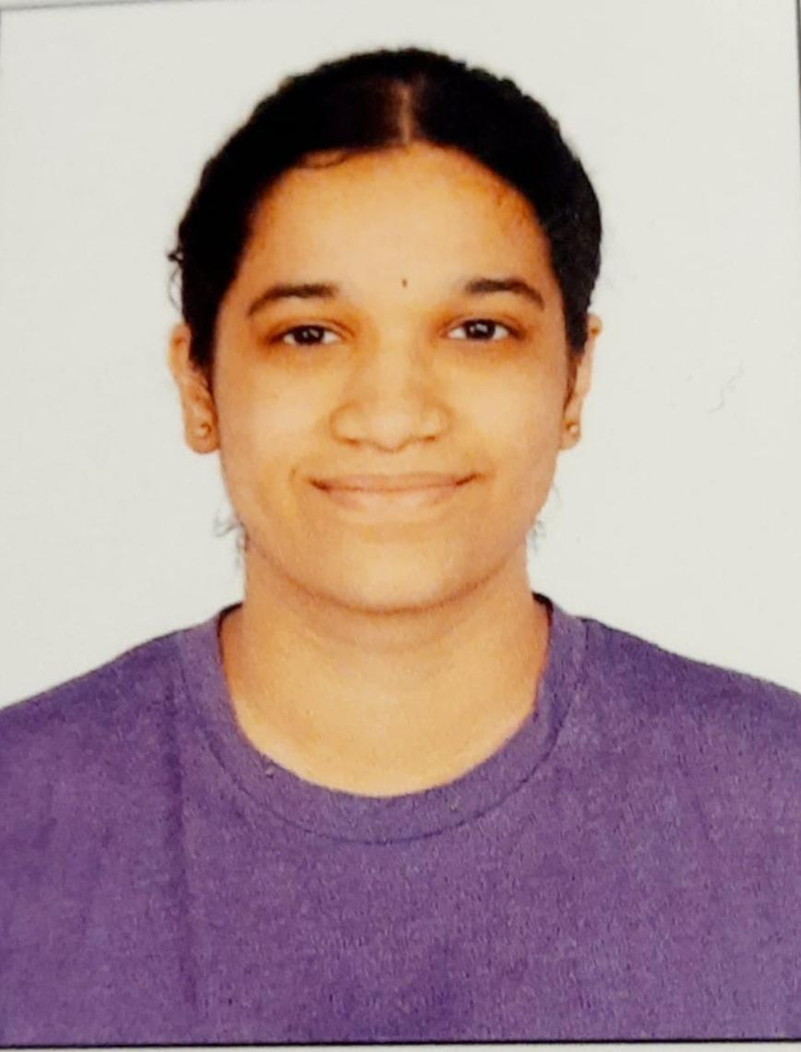
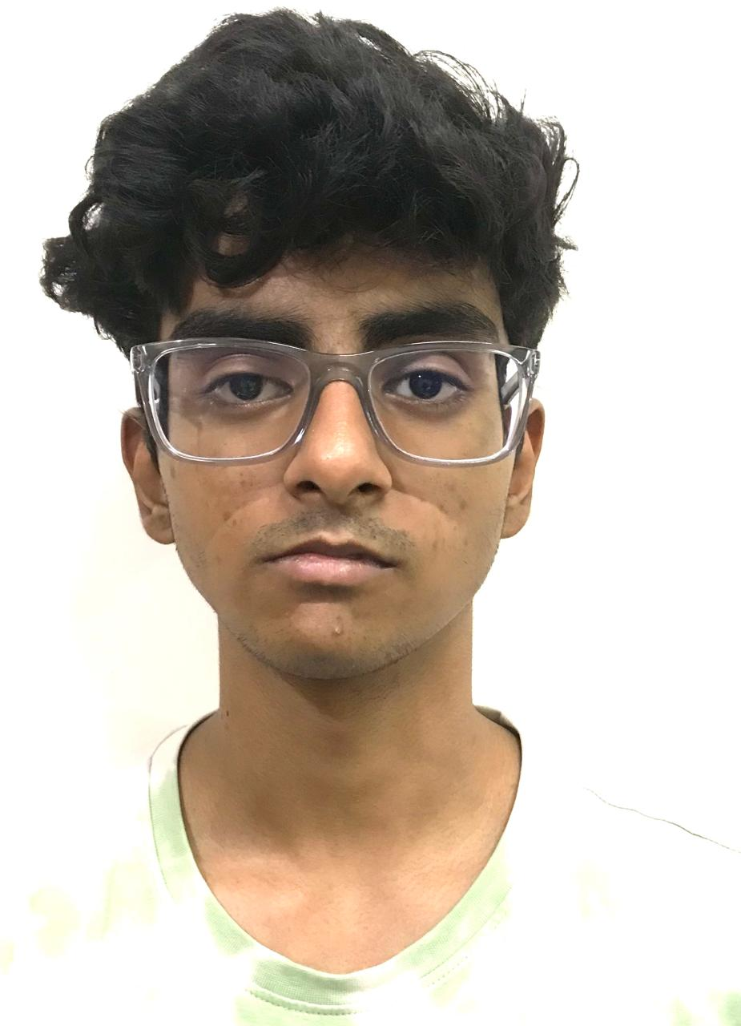
Composition of Team
Name:G.D.Pranav Lakshminarasimhan USN:1RV24ME038
Name:Sumukha Upadhyaya
USN:1RV24IS130
Mentor Name:Dr. Nivya Muchikel
Designation:Assistant Professor
Dept:Mathematics
Name:Aarti Shirvante Pai
USN:1RV24CS006
Name:Akshay Avinash
USN:1RV24CS027

Slide 3
EL Phase-III
Presentation Outline
Introduction
Project Overview
Comments during EL Phase-II and action taken.
Tools and Techniques Used
Project Progress
Analysis of Results
Deliverables and Outcomes
Conclusion

Slide 4
Introduction
Overview of the topic:
This project, HeliXR, integrates Augmented Reality (AR) and Digital Twin (DT) technologies to create an immersive, interactive model of food manufacturing operations.
It provides a real-time virtual replica of the physical plant, allowing users to monitor supply chain data, visualize processes, remotely control equipment like valves via touch or voice commands, and identify operational issues through data analysis.
This can be further extended to other industries as well with minimal efforts.

Slide 5
Project Overview
Problem Statement:
AR/VR-enabled monitoring system with an AI voice assistant to enhance real-time decision-making and operational efficiency in industrial supply chains
Context of the Problem:
Manufacturing industries struggle with slow, manual monitoring and control processes, which can lead to inefficiencies and costly errors.
AR/VR digital twin solutions offer real-time visibility and remote control, helping to improve safety, reliability, and productivity.

Slide 6
Main Objective:
Website to monitor data from sensors.
Voice Assistant which plugs into app and website, which controls the supply chain processes as per user requests.
App implementing AR/VR and Digital Twin Technology to visualize the supply chain.
3D printed model for live demonstration of concept.

Slide 7
Importance of the topic:
Real-Time Control: Enables instant monitoring and remote operation of equipment, improving response times.
Increased Efficiency: Optimizes processes, reduces downtime, and streamlines maintenance with predictive insights.
Enhanced Safety & Quality: Supports better training, quality control, and rapid problem detection.
Traceability: Improves tracking of products and processes across the supply chain.

Slide 8
Expected Contributions to the Field:
Our project is expected to contribute to the field by advancing AR/VR digital twin technology for manufacturing systems, enabling real-time monitoring, remote control, and fault detection across the supply chain.
It will also pioneer intuitive touch and voice interfaces for supply chain control, enhancing user interaction and operational efficiency.

Slide 9
Comments during EL Phase-II and action taken
The 3D model was printed but wasnt integrated with the website. We were asked to integrate everything and make the model work.
The purpose of the model was unclear.

Slide 10
Action taken:
The model was integrated with the website and performs actions as prompted. From the website the values are inputted into the database and the model accesses the values from there.
The model was also stabilized so it can be used in real world scenarios.

Slide 11
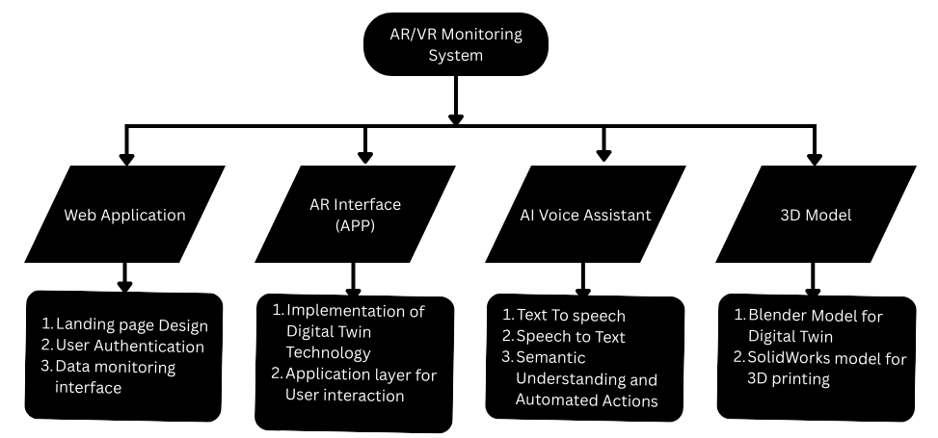
Methodology

Slide 12
Tools and Techniques Used
Software tools:
Website: HTML, CSS, Js, 3js, Flask, SQLAlchemy.
Database: MongoDB
Voice Assistant: TTS- ChatterBox
STT-Gemini 2.5 flash
Text processing - Gemini 2.5 flash
3D model: SolidWorks ,Onshape
Electronic connectivity: Raspberry pi for connections and sensors.

Slide 13
Reason behind above tools:
Flask helps with seamless integration of backend and frontend of websites and hence it was chosen.
MongoDB is a noSQL database which is very useful for building scalable applications.
Gemini was used due to its advanced language understanding, reasoning capabilities and ability to handle multimodal inputs (text, audio, etc)
3D model was made using SolidWorks for live demonstrating and was 3D printed later.
Raspberry pi was used because of its higher processing power.

Slide 14


Slide 15
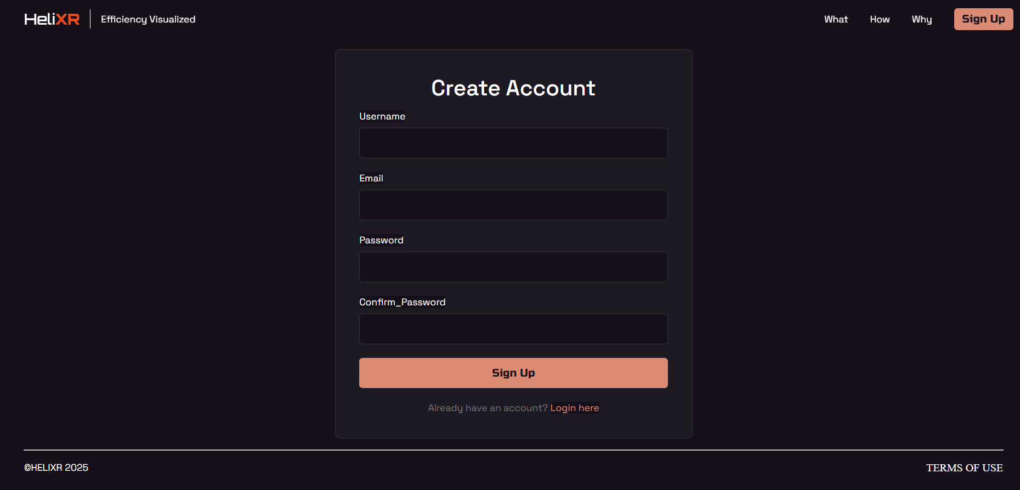

Slide 16
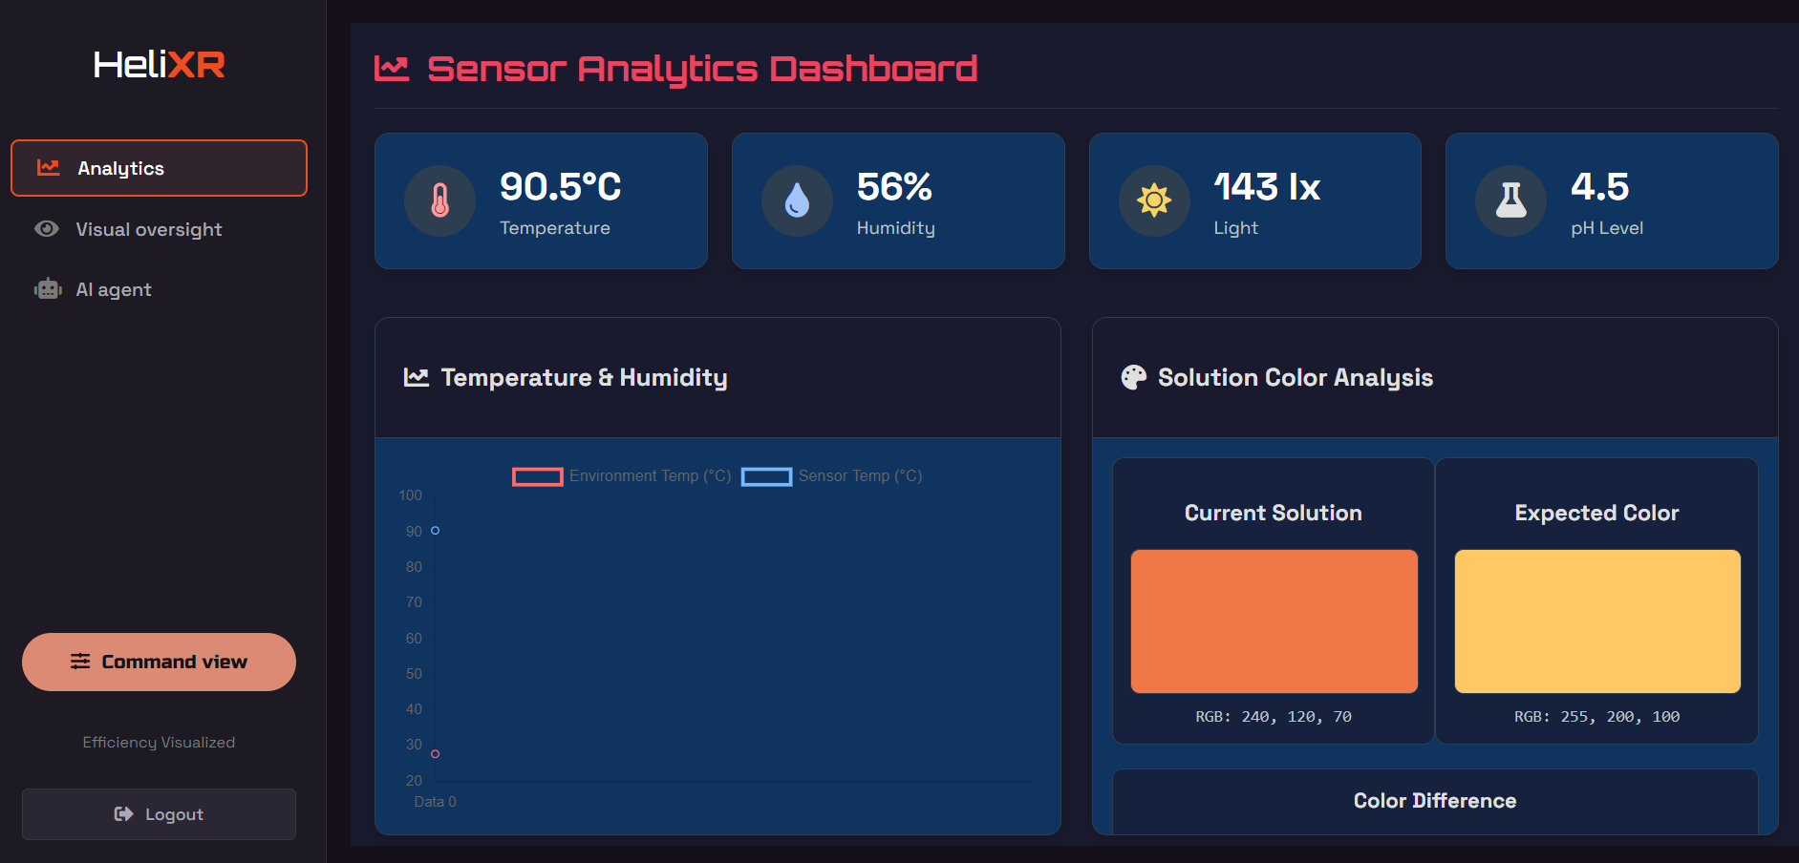

Slide 17
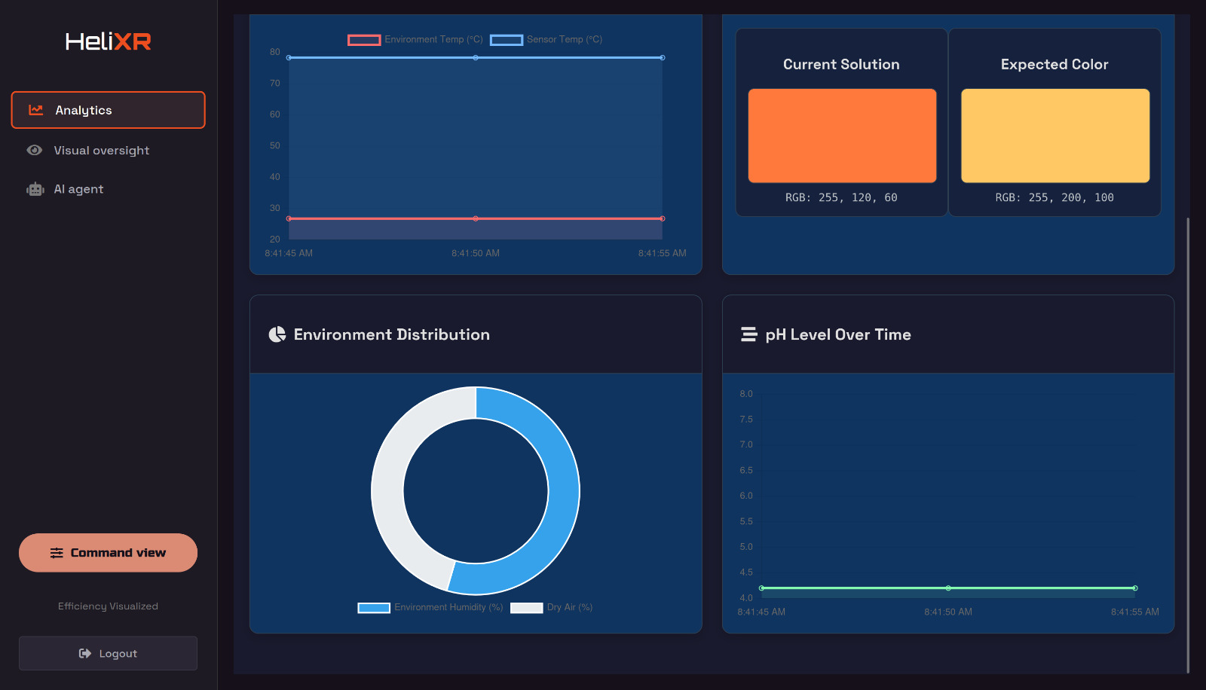

Slide 18
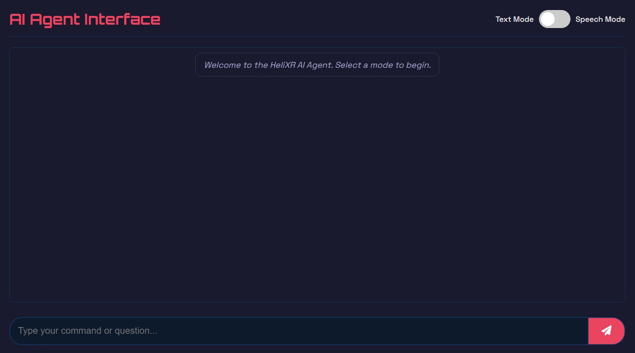

Slide 19
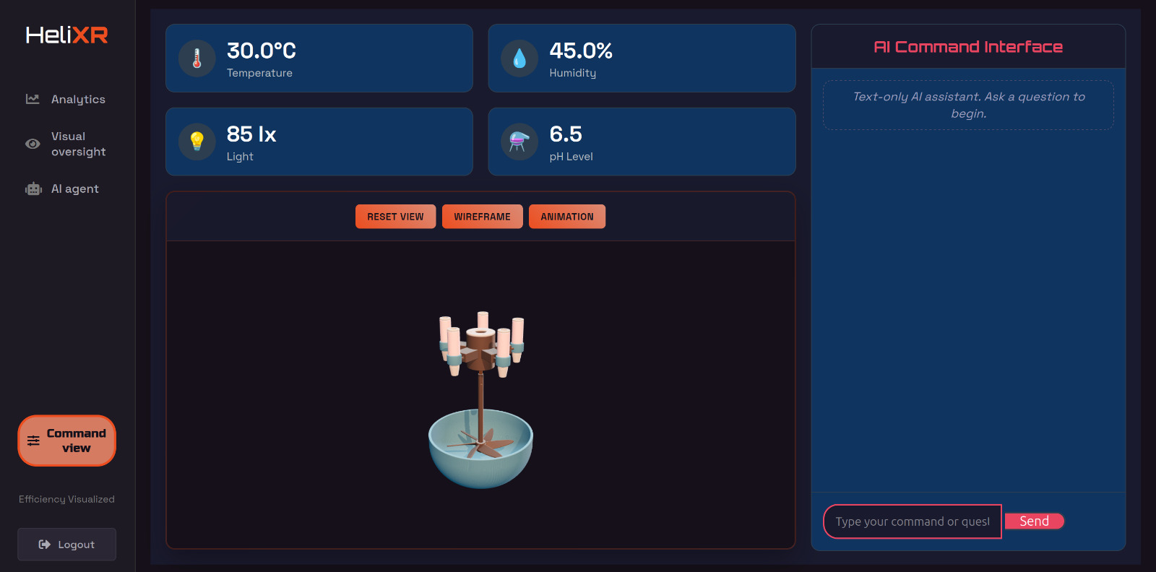

Slide 20
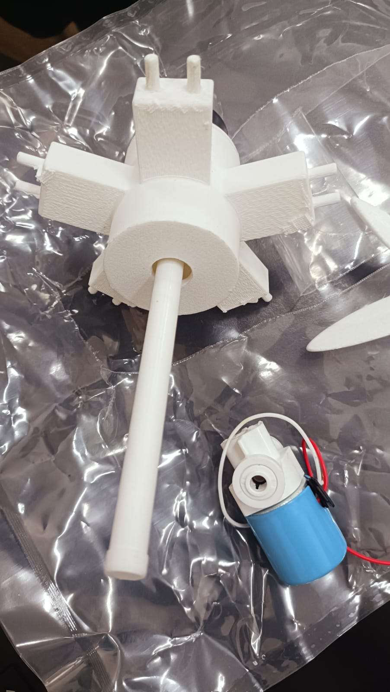
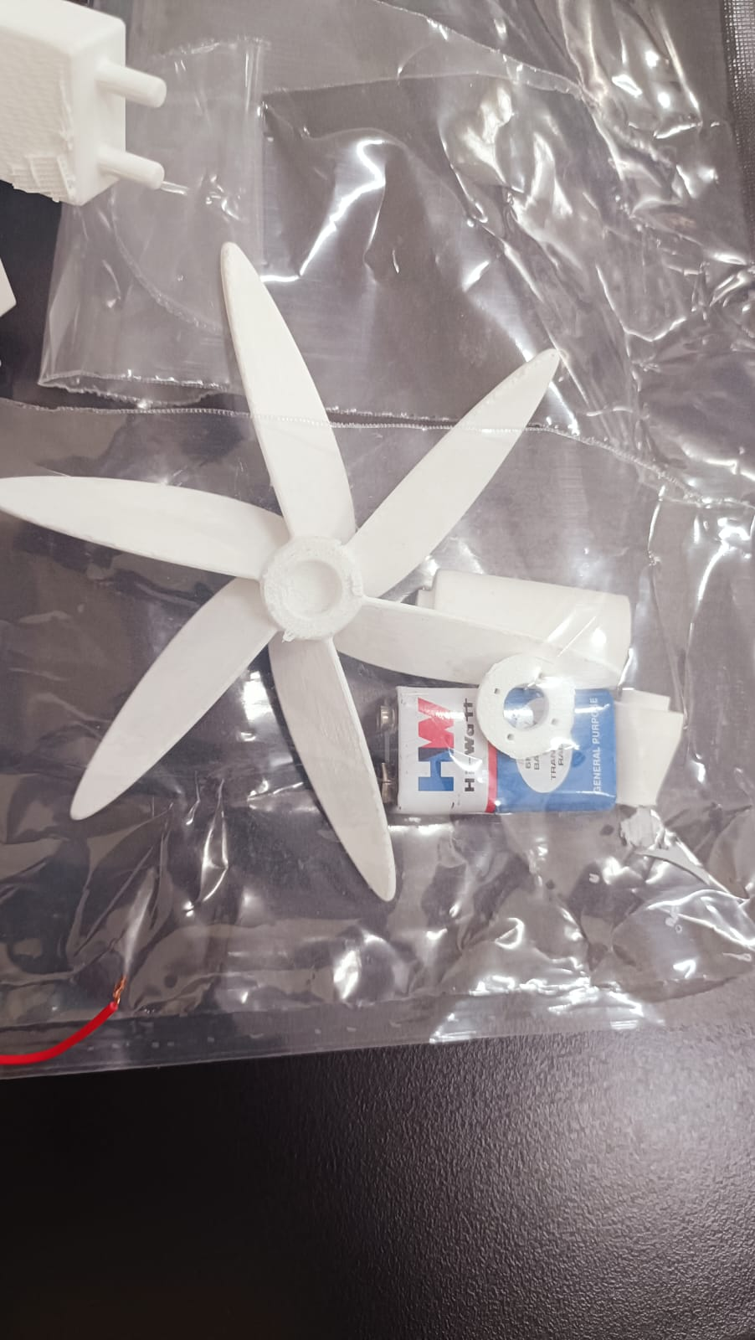

Slide 21
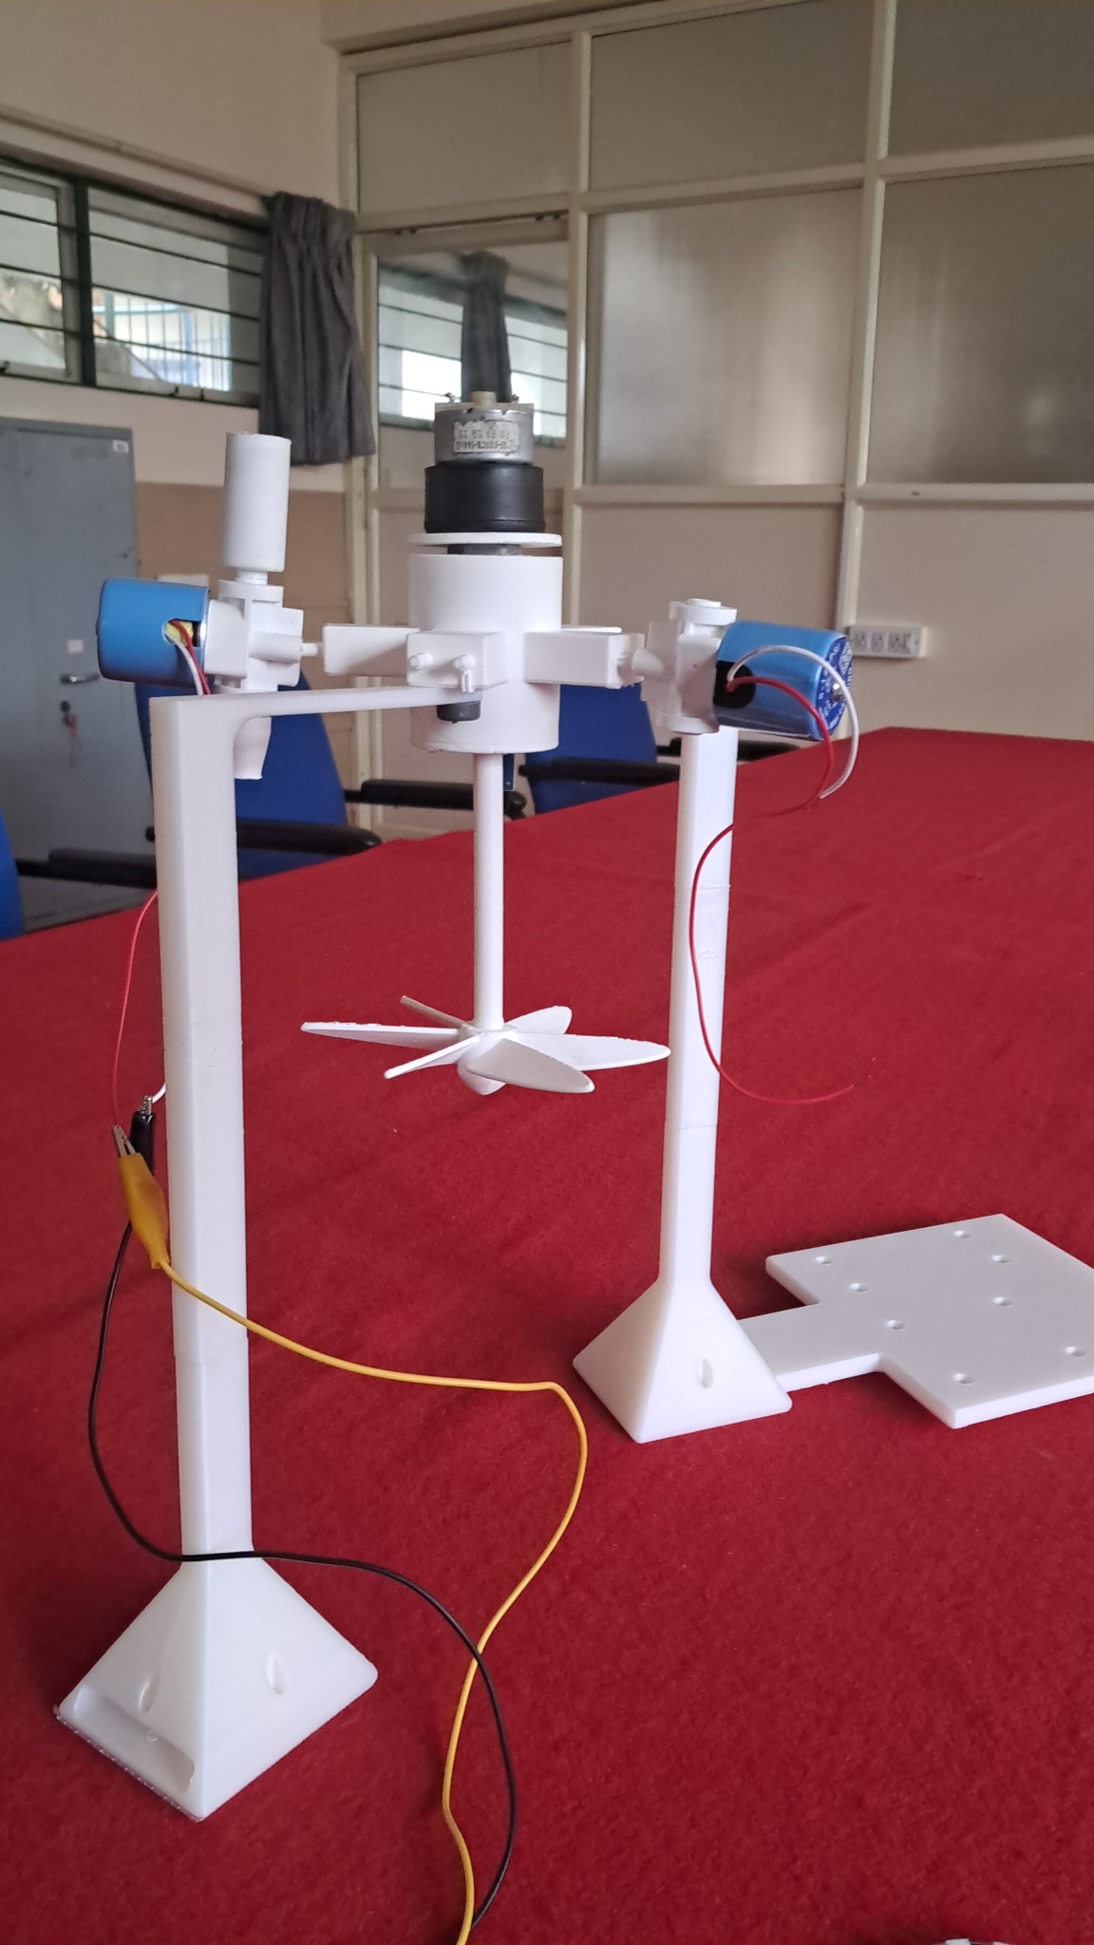

Slide 22
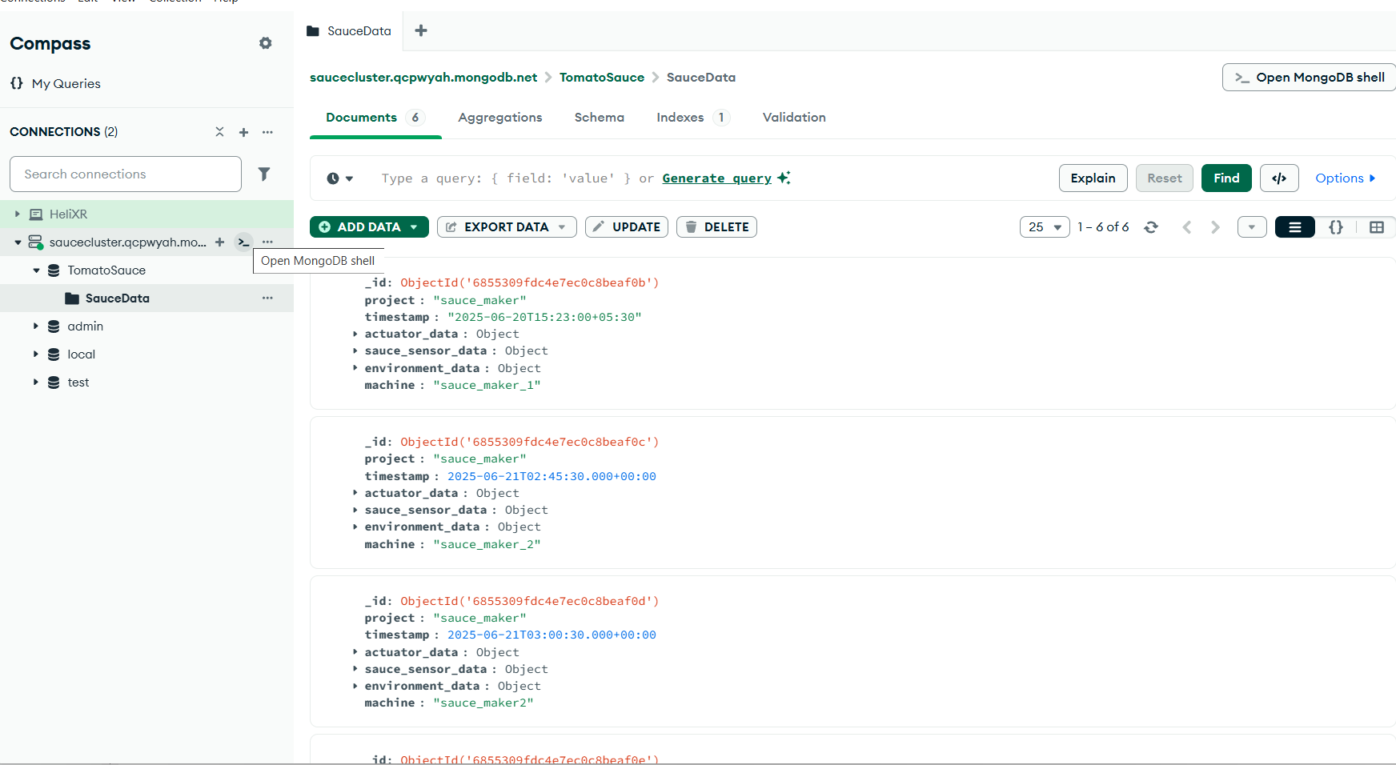

Slide 23
Analysis Results
Performance metrics show ±0.1°C temperature accuracy, 78.7% data reliability, ±2% RH precision, and 78.5% uptime, ensuring robust monitoring.
Pressure units achieve ±0.25% accuracy with sub-10s updates for critical safety.
AR-guided workflows cut manual intervention time from 45s to 12s, reducing errors.
Voice control works with 52% command recognition in noisy environments.
Edge computing with Raspberry Pi and cloud platforms like mongoDB enable real-time analytics and AR/VR digital twins.
Automated HACCP monitoring cut temperature excursions by 65% and audit prep time by 75%, boosting food safety and compliance.

Slide 25
The above website contains detailed analysis of parameters given by the 3D model and AR app.
The color comparison panel shows what the expected colour should be and what it currently is.
The first graph compares the temperature of the environment vs the temperature of the sensor. This helps in detecting if there is any exothermic reaction by comparing the two temperatures.
The environment graph shows the current environment humidity and temperatures.
The pH graph is plotted with respect to time to check whether there is a sudden change in pH.

Slide 26
Timeline:
1st week: connectivity of sensors to 3D model and passing values to database.
Visual model for website has to be made
2nd week: bilateral connection of AR app and 3D model along with incorporation of voice AI.
A research paper has to be written.
Challenges:
Since the AI agent is a black box it is hard to make it access the database for returning and pushing values.
Accuracy of shutting the valves is necessary.

Slide 27
Progress in Phase 3:
The website and AR app were connected to the 3D model and communications with the website change the parameters of the model (rotor speed, valve conditions)
An IEEE paper was composed using the data we received from the model.
An IR sensor was added to count the RPM of the rotor

Slide 28
Conclusion
Integrated IoT sensor: We deployed a robust network of IoT sensors.This enabled real-time, accurate data collection across the supply chain, improving food safety compliance and providing a foundation for predictive maintenance.
AR platform: We used Unity to build an AR app. This allowed operators to visualize equipment status and process flows in real time, leading to faster issue detection and more informed decision-making.
Voice Control Integration: The addition of a multi-language.allowed hands-free operation of all valves and system commands. This not only enhanced accessibility and safety in noisy industrial environments but also streamlined workflows and reduced operator workload.

Slide 29


